Slide 1

HRE PROJECT
A STATUS REPORT
Don Ferguson
https://historyresearchenvironment.org/
Disclaimer. Wholly Genes, Inc., the developer of The Master Genealogist (‘TMG‘), is not directly involved in the HRE project and will not provide technical support nor assume any responsibility or liability for the project.

Slide 2
First, who am I?
TMG user since 2001
Founder member of HRE Ltd
Currently Secretary of HRE Ltd
Controller of HRE documentation, code set
Part time HRE coder.

Slide 3
This morning we will…
Review what we said HRE was all about
Review the originally planned development steps
Update you on where we actually are
Have a look at what we have built so far.

Slide 4
1. SO - WHAT WAS HRE ALL ABOUT AGAIN?
An application to record History, not just Family History
To provide an ‘escape-route’ for TMG users
To work across multiple platforms
To be based on modern IT products
To support Unicode, multi-language, multi-user.

Slide 5
1.1 A HISTORY APPLICATION
For the history of other objects -
Land, Companies, Villages, Art Collections, etc
To be able to view data in several ways
And to recognise not all research is focused on people, even if they are always part of a history.

Slide 6
1.2 WHY REPLACE TMG?
Because TMG is no longer supported by its maker
Because no other program matches its capabilities
Because nobody else has provided a functional replacement.

Slide 7
1.3 MULTIPLE PLATFORMS
Users demand multi-platform support, not just by emulators, which means
  Windows (which we develop on)
  Mac (which we have tested on)
  Linux (which we will also support).

Slide 8
1.4 UPDATED TECHNOLOGY
Supported language (Java)
Supported SQL database (H2)
Built using other commonly available current technology open-source products.

Slide 9
1.5 MULTI-LANGUAGE,
MULTI-USER
HRE has multi-language support ‘designed in’
Projects may be under single-user control on one computer
OR shared with other users
OR run in a client-server, multi-user mode.

Slide 10
2. THE ORIGINAL PLAN STEPS
Version 0.1: initial HRE for creation, backup, restore, delete, rename of project databases. Allow entering, editing and display of Locations under the control of editable Location Name Style Definitions
Version 0.2: add Persons, Flags
Version 0.3: add Events and Tasks
Version 0.4: add Source, Citation, Repositories
Version 0.5: add Images, External Files. At this stage all data from a TMG project should be importable
Version 0.6: add Reporting

Slide 11

3. WHERE WE’VE GOT TO
Version 0.1: build initial HRE to allow creation, backup, restore, delete, rename of databases. Allow entering, editing and display of Locations Persons and their Names under the control of editable Name Style Definitions.
Version 0.2: add Persons Locations
As you can see, we ended up reversing Person and Location Names; also the ‘entering, editing’ part is not complete, so we’re at about v0.1 and a bit.

Slide 12
4. WHAT EXISTS NOW
We have built a backbone that supports manipulation of projects (create, copy, rename, backup, restore, delete, etc) and other functions
We have built a TMG import process for Names, Locations, Dates – but not complete Events, nor Flags, Tasks, Sources, Citations, Repositories, Images
We have built display screens for this data.

Slide 13
4. WHAT EXISTS (continued)
We have also added a number of other tools not mentioned in the original plan, such as:
  a multi-language context sensitive Help system
  a Windows installation packager (extendable to the Mac environment)
  extensive ‘look and feel’ capability with many different theme color/font size combinations.

Slide 14
5. A SPECIAL THANK-YOU
At this stage I’d like to ask Tracey to take a virtual bow for his unsung efforts running the HRE mailing list
The HRE project relies entirely on volunteer efforts such as his and we all wish Tracey the best for his continuing recovery

Slide 15
6. A BRIEF DEMONSTRATION
We now want to take you on a brief tour of HRE as it currently exists
As you will appreciate from the previous slides, there is still a lot of undeveloped functionality
Bear in mind that nothing you see today is set in stone – anything may change as we move towards the first ‘release’.

Slide 16
6A. About the HRE Demonstration
We now present a running version of HRE v0.1 Build 25.
Screens showing real data are all populated by HRE’s import of data from TMG projects.

Slide 17
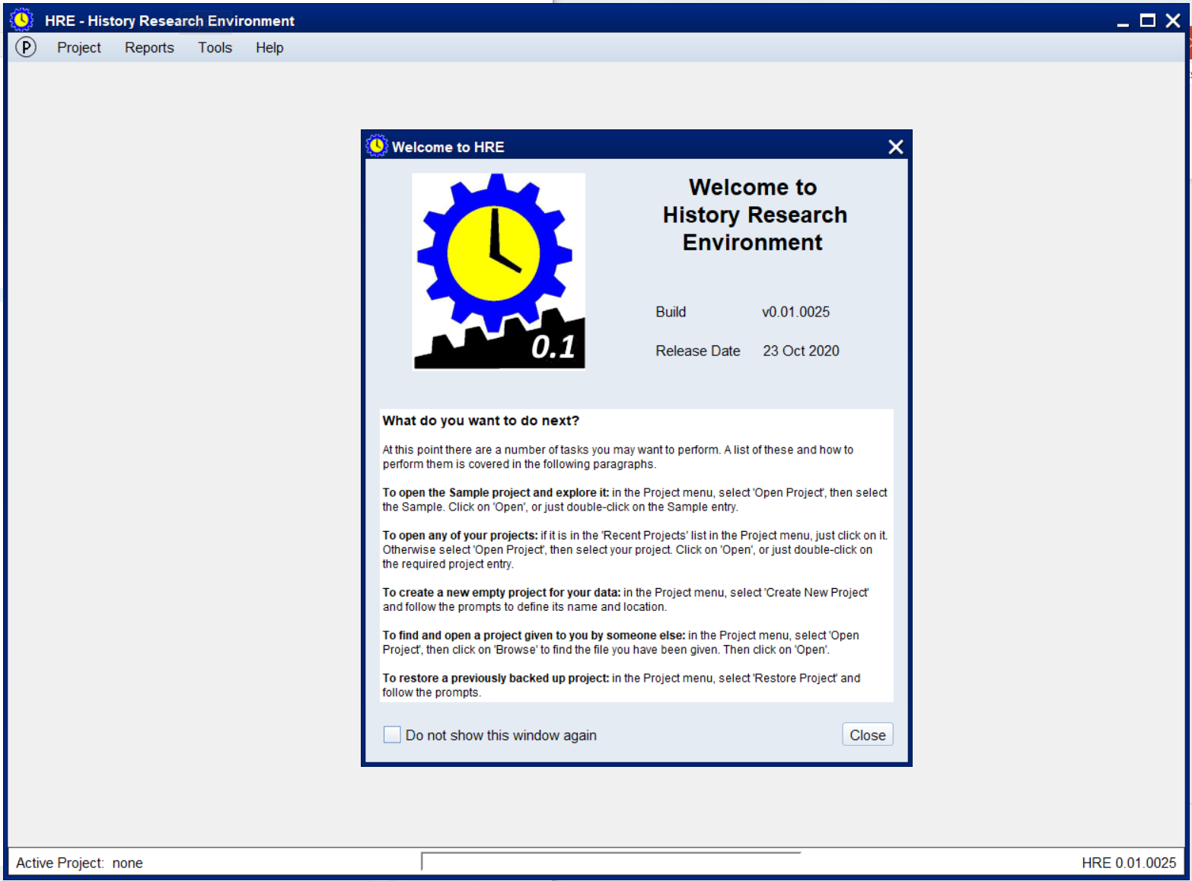
Notes:
On HRE startup you get this Welcome screen, which gives you some hints on how to proceed.
It can be turned off, of course, as most of you will do as you get comfortable with HRE
Actually this is the 2nd form of the Welcome screen – the real first one asks for your name and email address, as this is saved in order to add it into HRE projects to identify them as yours. Once done, you then get this form of the screen.
You’ll notice the main menu looks a bit small – this is because we don’t have a project open yet

Slide 18
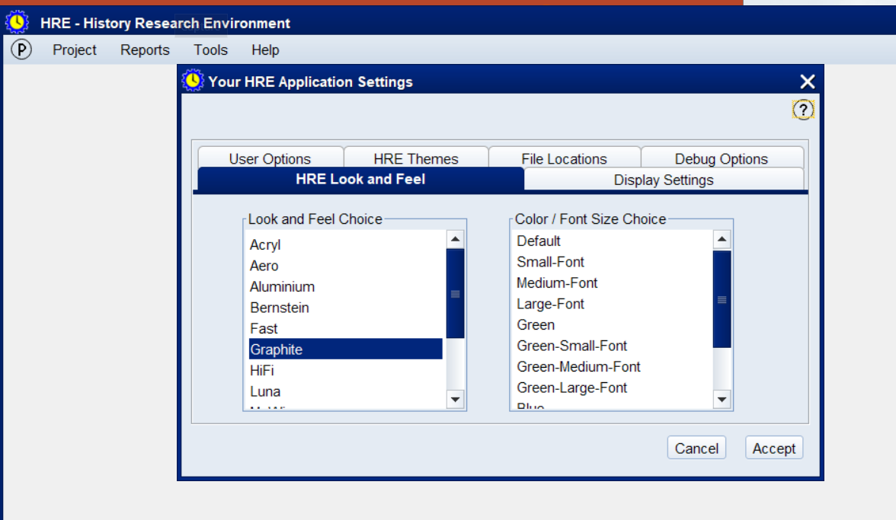
This is what you see by opening the Tools->Settings->User menu. In this tab, we can set the ‘Look and Feel’ of HRE. In total there are 132 theme/color/font combinations available, although some are truly awful….
Notes:
First, we want to explore the HRE settings and the Help system and then we’ll open a project.

Slide 19
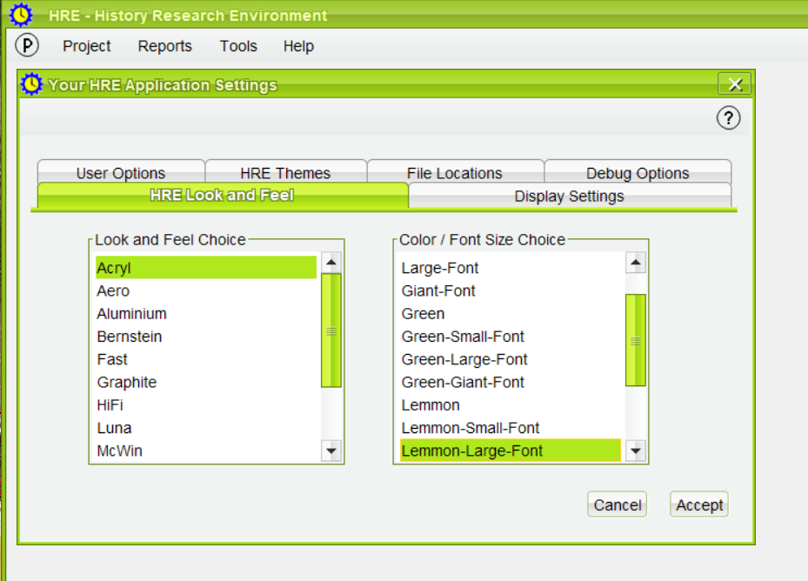
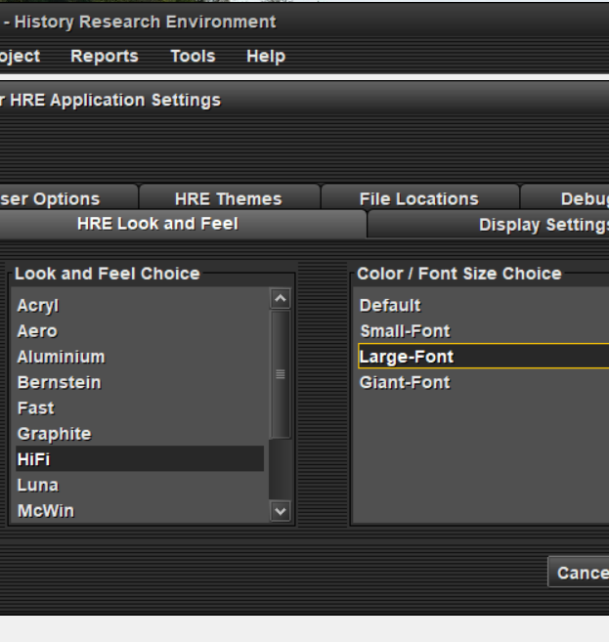
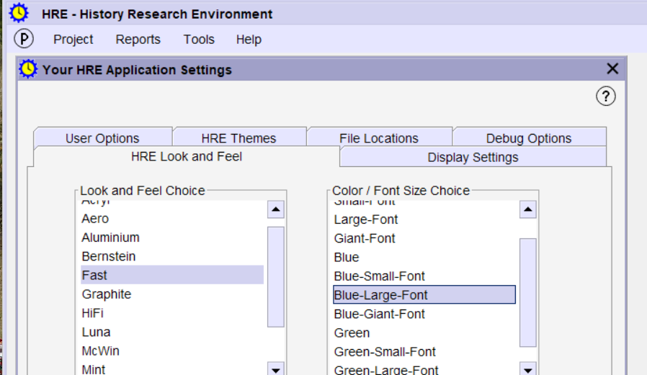
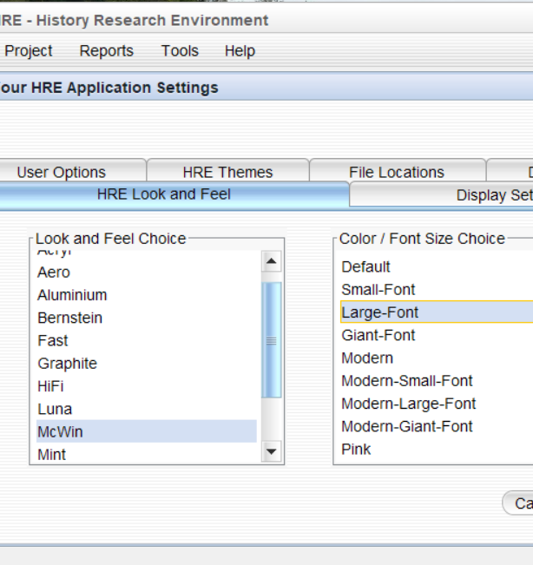
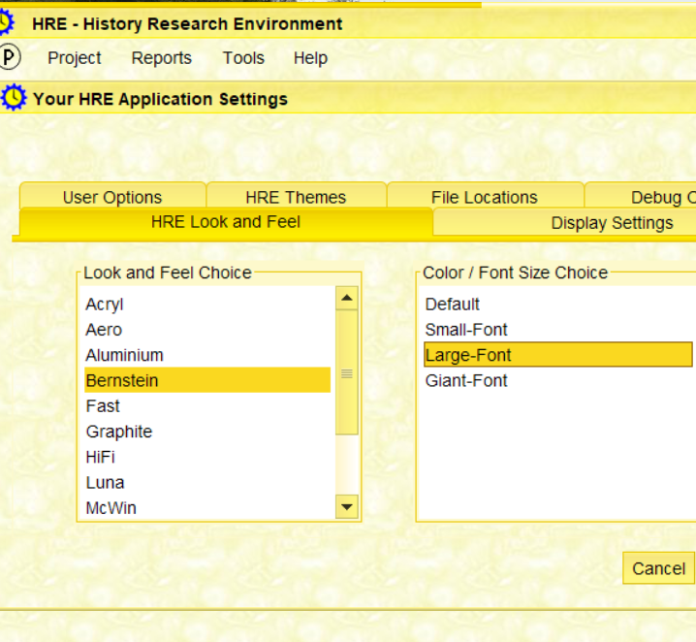
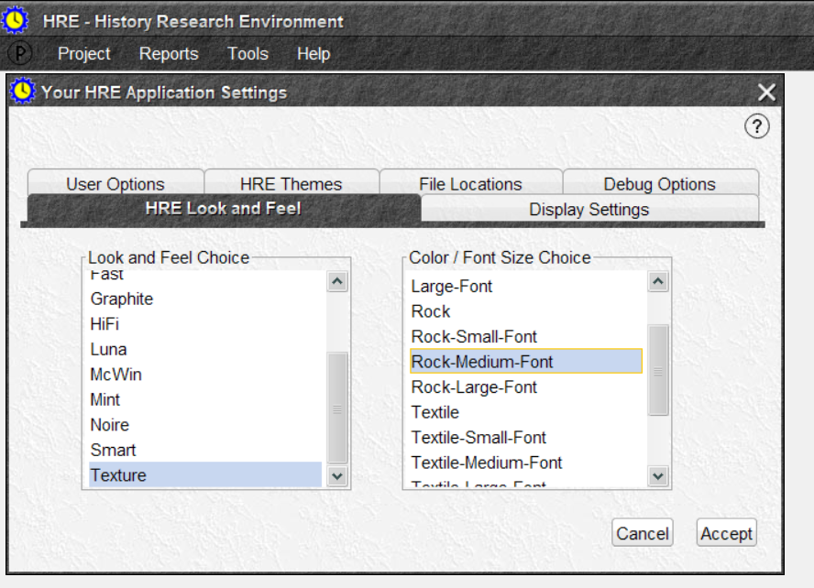
Notes:
Some of the theme and color choices – yes, some are horrible, but may help the 20% of us with color-blindness..
You’re probably also thinking ‘why did they waste their time doing this rather than building the rest of HRE’?
Well, we didn’t. This functionality comes from an open-source tool we’ve incorporated into HRE. Yes, it took a couple of days effort but it also solved two technical issues in Java which we’d have had to spend a lot of time addressing if we hadn’t used this method.
So it was a win-win to get past those issues AND provide support that may help the vision-impaired.

Slide 20
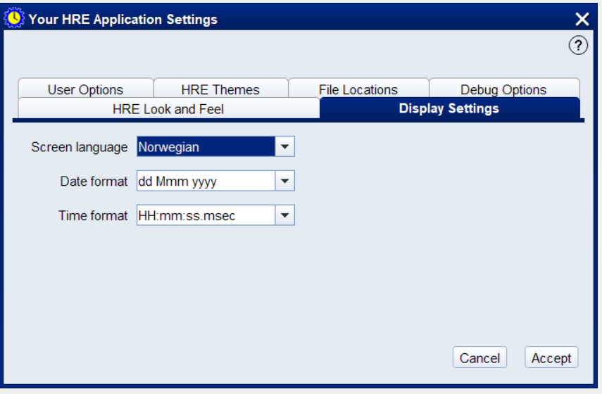
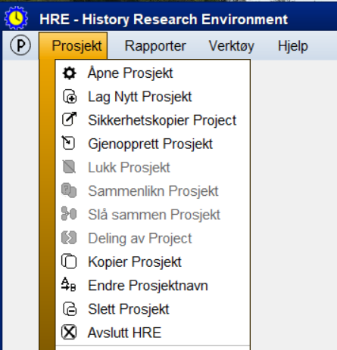
Next tab offers various options – if I choose Norwegian language, for example, that’s exactly what the menu will display.
Notes:
Although the menu changes to Norwegian, nothing else (apart from the Welcome screen) has yet been translated.
What we’re showing here is that the functionality exists and can be extended.
As screens enter a ‘finished’ state it will make sense to convert them to multi-language (a simple process), then add the translations, if we have the required translator skills.

Slide 21
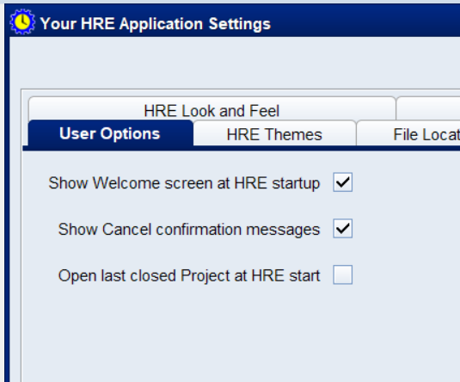
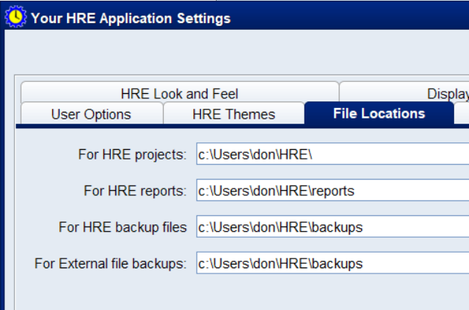
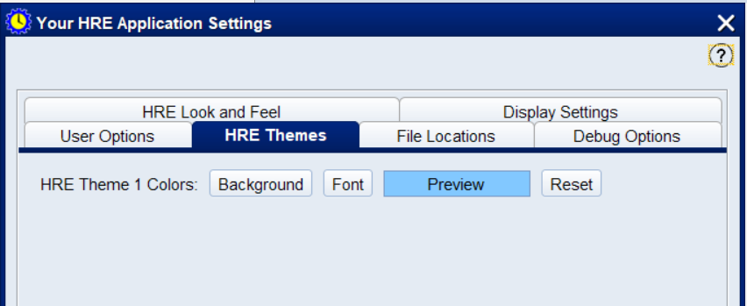
This shows the content of some of the other Option tabs. Although only one ‘Theme’ color is setup, we will expand that to offer the capability to add multiple HRE themes
Notes:
This shows some of the other Setting tabs – obviously these will be extended as more functionality is provided and more options are defined.
The HRE Themes tab only has one pre-defined color set, but more will be added.

Slide 22
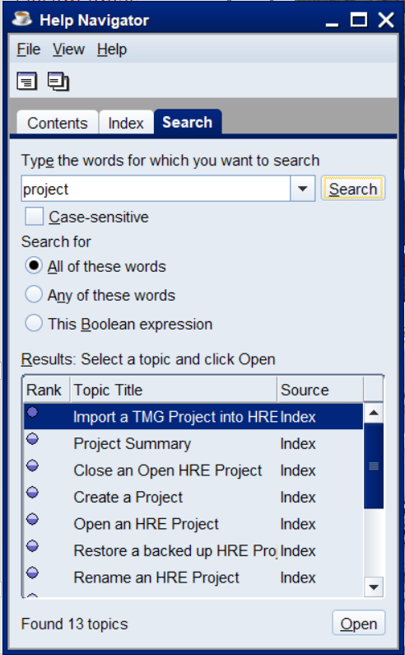
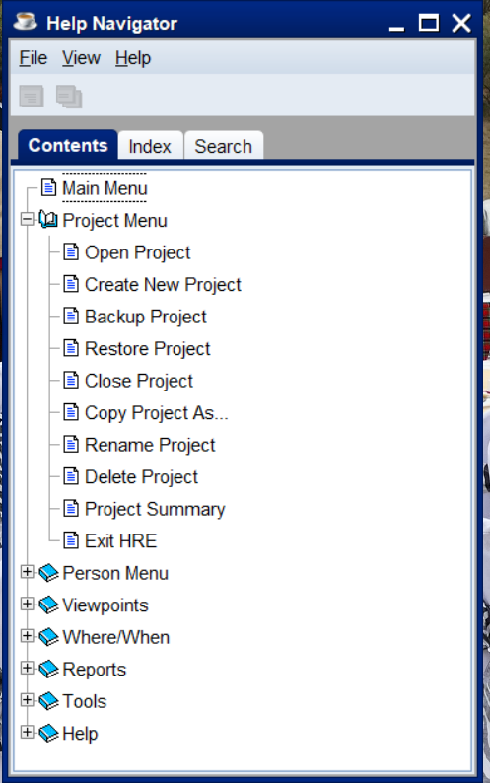
The Help menu displays the Help Navigator initially.
The major entries reflect the main HRE menu items, which open up to show the individual menu entries.
The Search tab opens a search screen – here showing the results of a search on the word ‘project’.

Slide 23
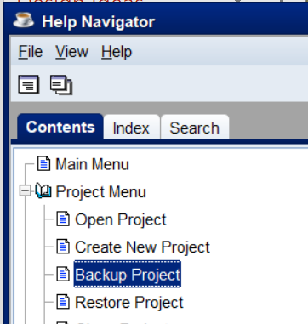
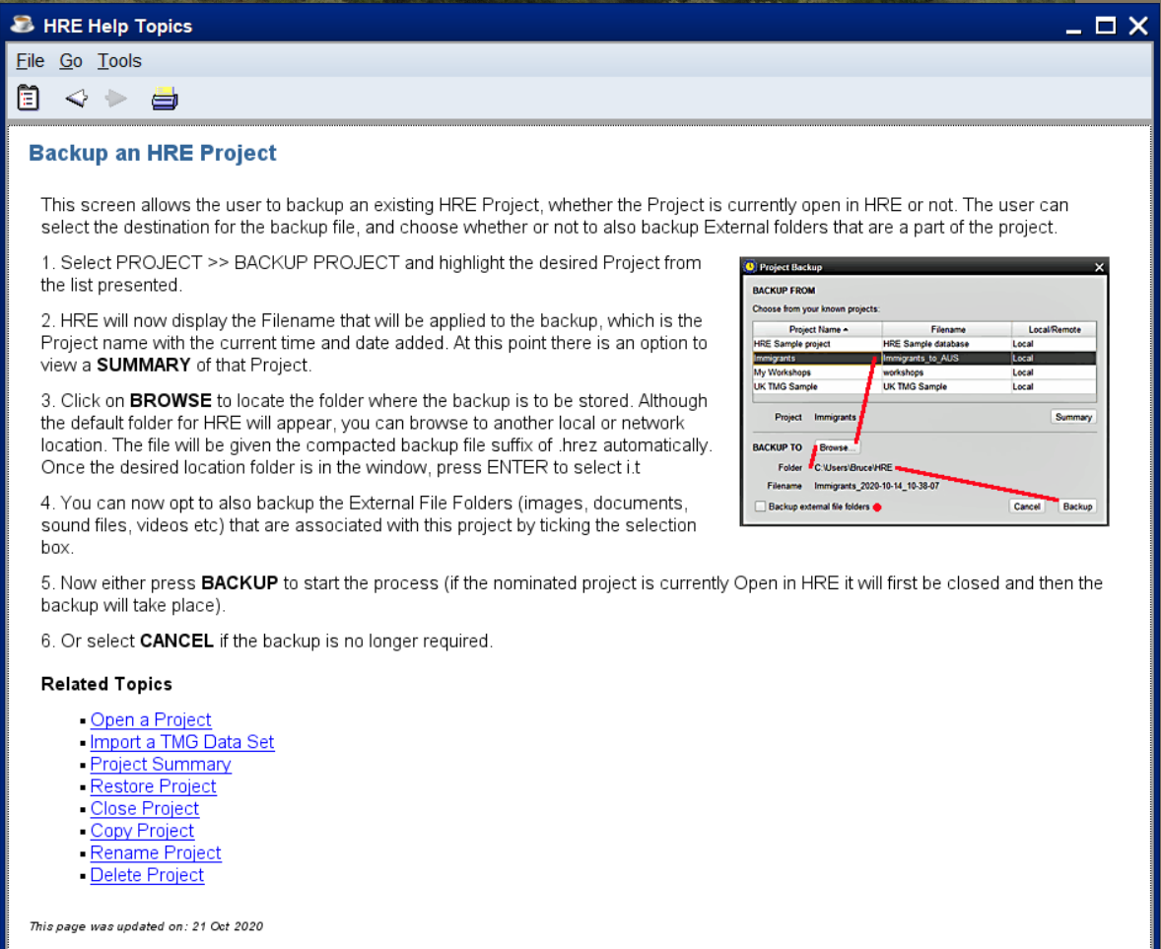
Selecting an entry in the Help system opens the relevant Help page – here’s the one for project Backup
Obviously, selecting the ‘Help’ icon on the HRE Backup screen (or pressing F1) would also open the same Help page.

Slide 24
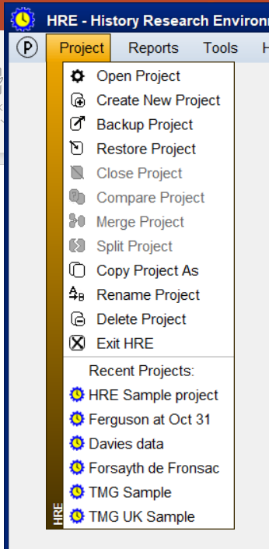
Looking now at the Project menu, we can see there are the expected entries for Open, Close, etc and then at the bottom a list of entries under the heading ‘Recent Projects’.
Although we can use ‘Open Project’ to open any HRE project, it’s much quicker to just click on an entry in the Recent list.

Slide 25
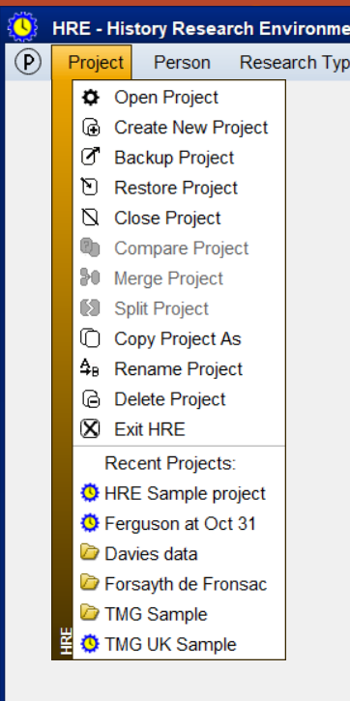
If we now open some projects, a number of things happen.
First, the full menu appears:
Also, the project menu’s Recent Project list reflects which projects we’ve opened:
Notice we’ve opened 3 projects – but which one is the ‘active one’? (by ‘active’ we mean which one is in read/write mode OR, which one will be the focus of any further activity like starting some other function).

Slide 26
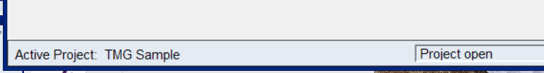
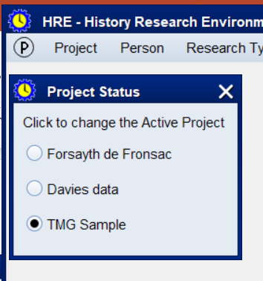
The answer is given to us in the HRE Status bar, at the bottom of the screen:
But you’re probably also wondering what the strange ‘P’ symbol is at the left-end of the menu – hovering the mouse over that gives you the answer AND enables you to change the Active Project with one click.

Slide 27
So now you’re probably wondering why nothing else appeared when we opened any of those 3 projects and in fact why nothing appeared when we opened HRE itself. This is because it depends on the Settings as to what happens. I purposely had the setting ‘Open last used project at HRE startup’ turned OFF, so we didn’t get distracted with other screens appearing.
HRE also remembers what screens were open last time you closed a project, so as I had closed all screens before closing these projects, nothing re-appeared at open time.
So we’ll now explore the Viewpoint screens.

Slide 28
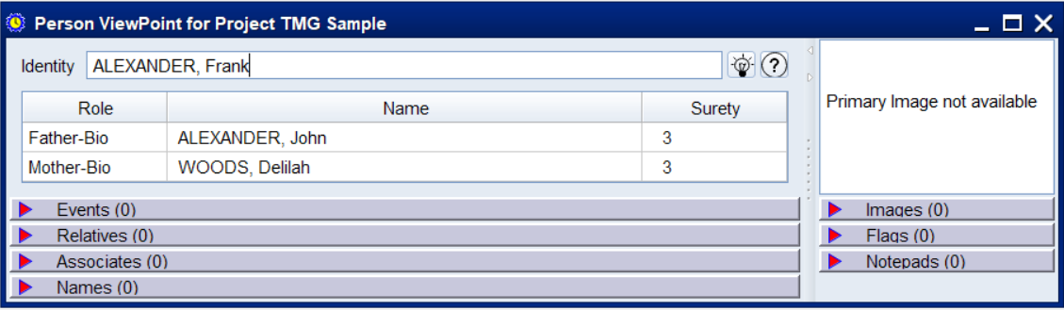
If we open the Person Viewpoint (remembering the Active Project is the TMG Sample project) we get something like this:
Notice that the project that owns this Viewpoint is in the title of the screen.
Each of the little triangle markers can be clicked to open up the relevant sub-panel, as we’ll show next.
You may have up to 5 Viewpoints open for each project, so with 3 projects open you could have 15 Viewpoints on your screen!

Slide 29
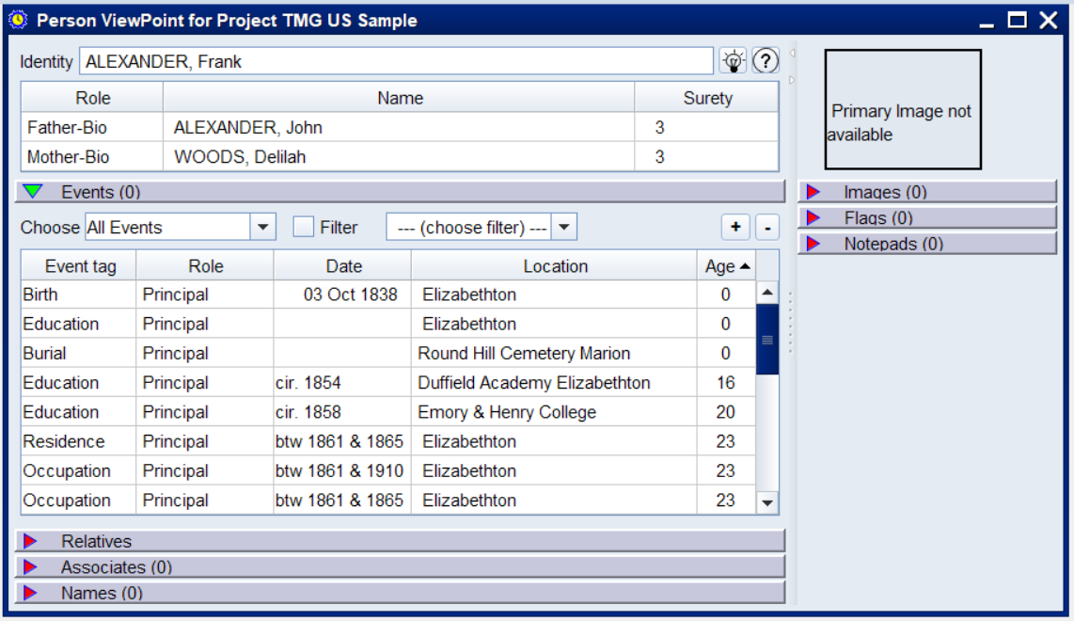
Here we’ve opened up the Events section. It starts with only 5 rows showing, but you can expand (or shrink) the table size by use of the ‘+/-’ buttons.
Notes:
Yes, we know some of the items on the screen aren’t ‘complete’ yet (like all Roles are ‘Principal’ which is not correct – this reflects this as being a work in progress.

Slide 30
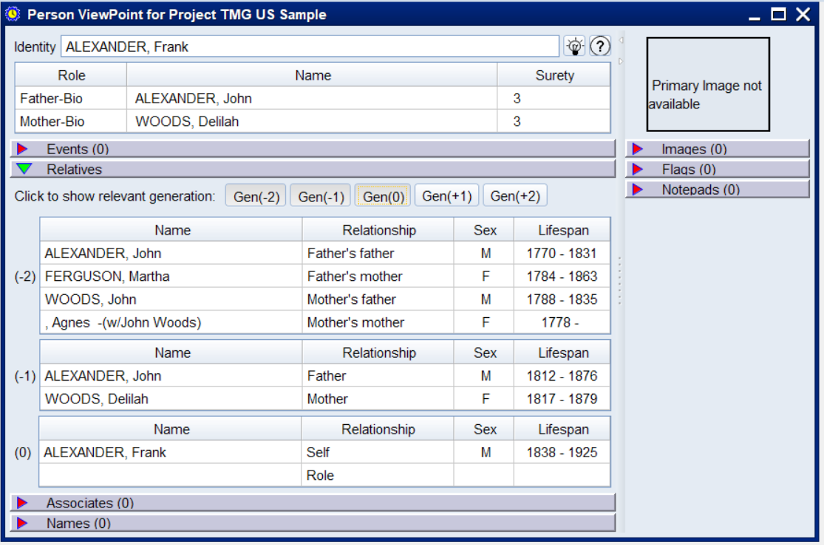
Here we’ve opened up some of the Relatives section (which is itself 5 sub-panels), which show the relevant details of each generation before and after the subject person.

Slide 31
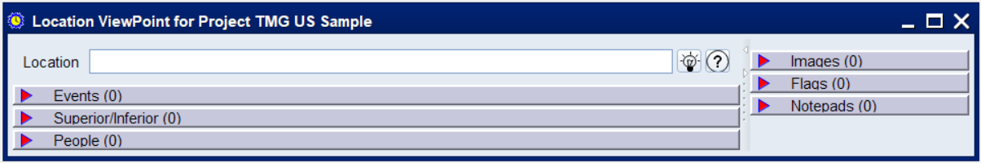
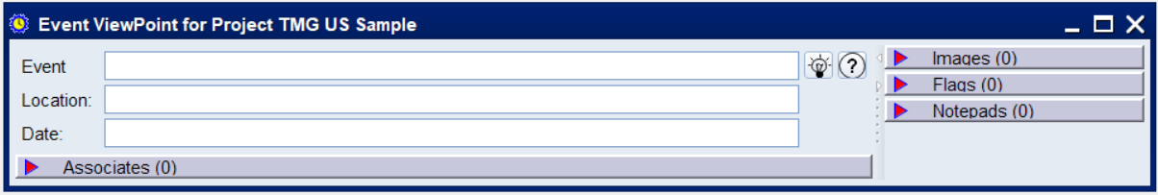
There are 2 more Viewpoint screens – Location and Event – although we are not yet populating them. But this gives you some idea of what we mean by differing views of data. If we had selected a Location from the Person Viewpoint and created its Location view it would fill in this screen, so that the Events panel would show all Events at this location and People panel would list all the people associated with these events: -
Likewise, the Event Viewpoint would give you all the things (including people) associated with the event:

Slide 32
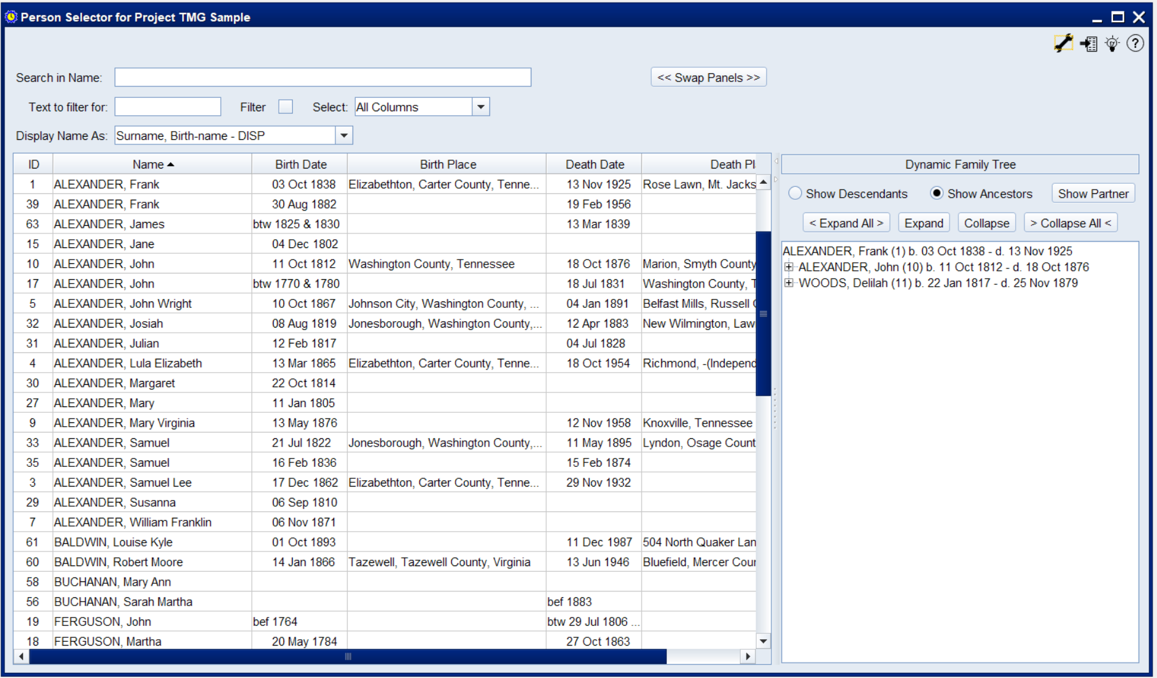
Next is the Person Selector – this is like the TMG View Person (or ‘picklist’) combined with a sub-screen on the right that acts to replace the Project Explorer.
Notes:
The size of each part of the screen can be adjusted; the layout of the sub-screens can be swapped, or each sub-screen can be made full screen by use of the small arrow keys at the top of the divider.
Any of the columns can be sorted in either direction; columns can be re-sized; columns can be re-arranged (all rather like Excel).

Slide 33
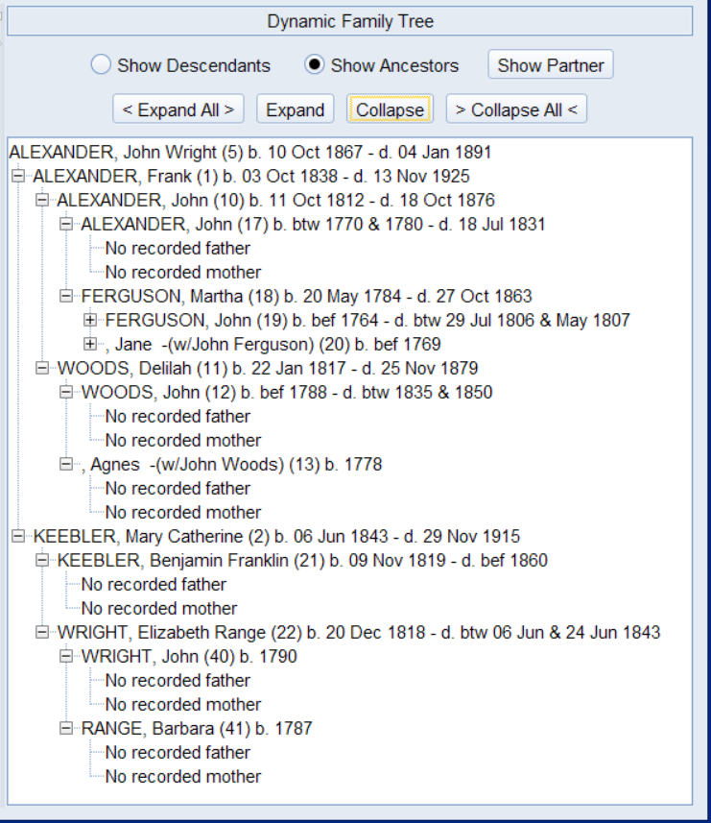
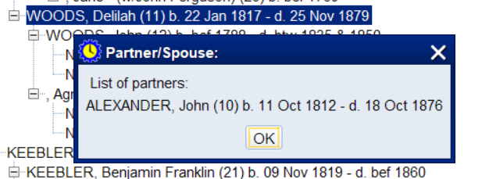
The right-hand tree facility can be used to display Ancestors or Descendants by use of the Expand/Collapse buttons or use of the +, - buttons within the tree.
Selecting a person allows display of their Partner:

Slide 34
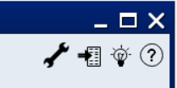
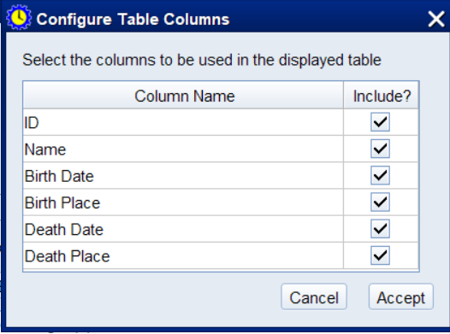
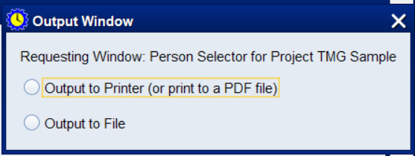
Lastly, a word about the icons appearing in the various screen toolbars, like these. The ? Icon is always for Help.
The spanner icon will display a screen that allows some form of configuration of the calling screen, such as this:
The next one allows Output of any table on the screen. It can be sent to the printer (or a PDF file) or written out to disk as a CSV format file (Excel compatible)

Slide 35
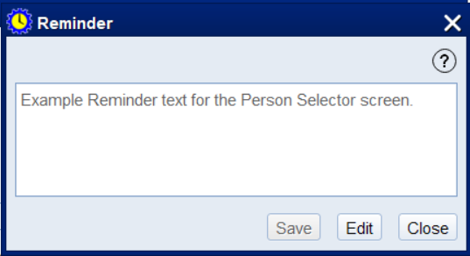
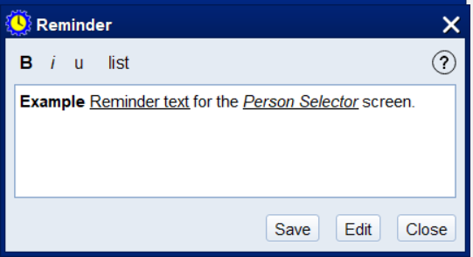
The light-bulb icon is for Reminder text, which you can edit as required.
If you click on ‘Edit’, an editing menu appears, which allows simple formatting of the reminder text in a variety of ways.

Slide 36
7. SKILLS WE STILL NEED
Java coders - adding more to the team will add the need for a another level of co-ordination, but we could handle a couple more
Translators for the major European languages. Only some screens have been setup in English, French, Norwegian, so all other screens need translation to other languages, as do the Help pages for each screen
Alpha testers? – we will exploit the existing registered pool

Slide 37
WRAP UP
Q & A
Don Ferguson (Melbourne, Australia)
don@ferguson.name
Robin Lamacraft
robin.lamacraft@internode.on.net

